Slide 1
N018R001L issue
Corrective Action Report
Date: 2018/12/11

Slide 2
Content
Issue Description
Root Cause Analysis
Risk Assessment
Corrective Action
Preventive Action

Slide 3
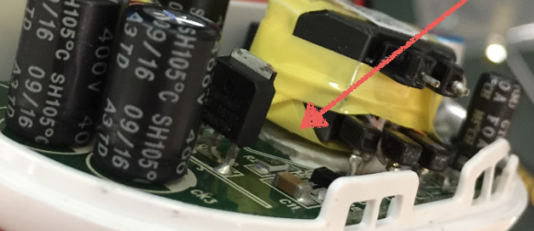
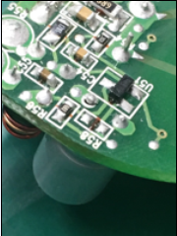
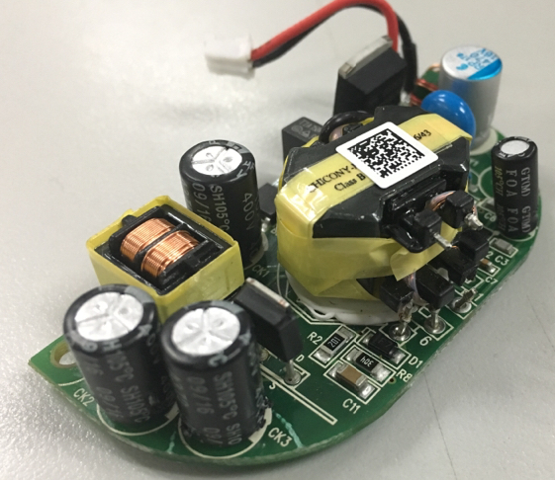
Issue Description
After drop test, the X'FMR Pin Crack
and the lead of the capacitor tilt

Slide 4
Root Cause Analysis
The tape makes the fixing glue insufficiently adhered
Soldering poor cause during drop test which the C52 solder point break

Slide 5
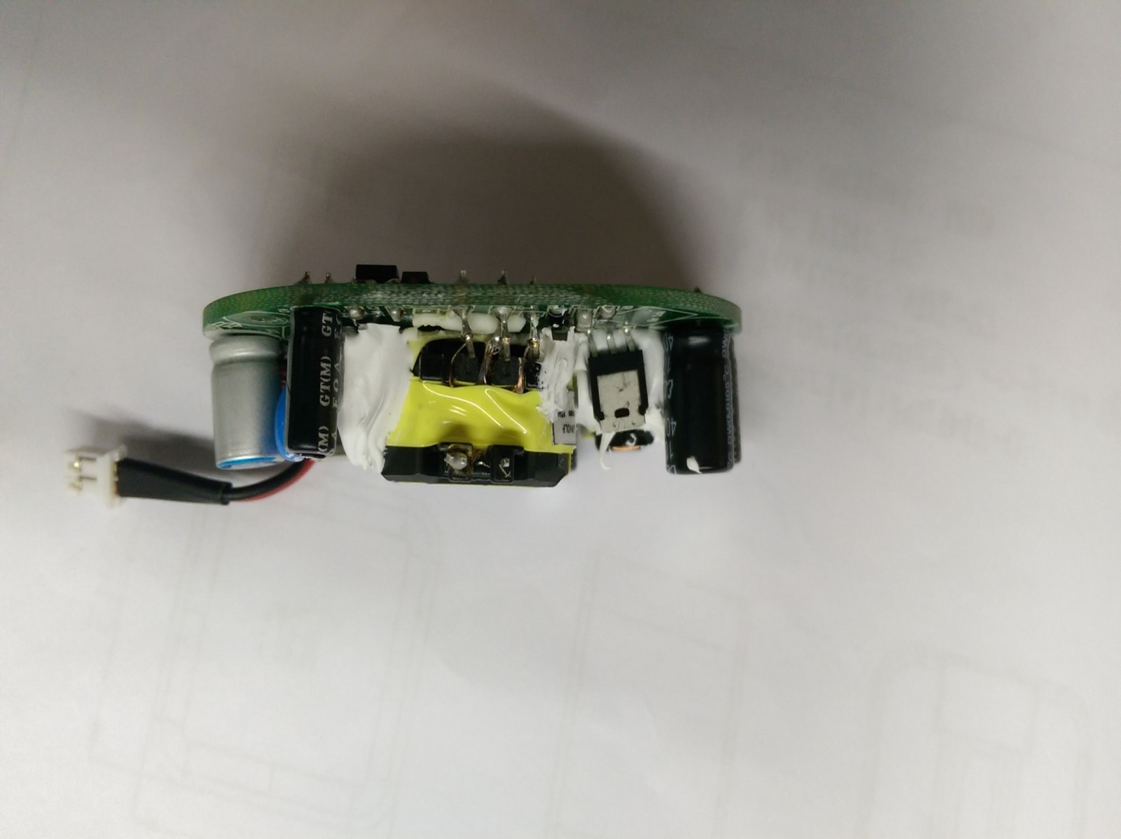
Risk Assessment
X'FMR pin crack will cause power transfer interrupt form primary to secondary side.
And the controller stop working that the output shut off.
The power resource would not supply to the terminal device.
The poor soldering of the capacitor exist potential risk of ripple and noise filter function and capacitor fixing structure weak.

Slide 6
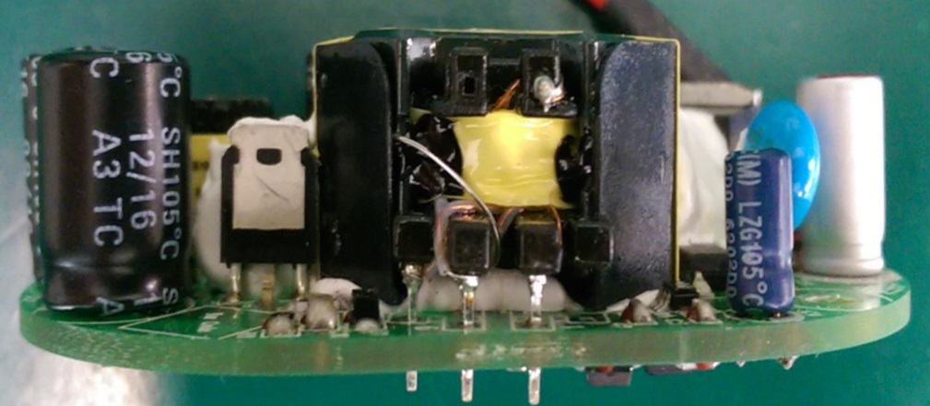
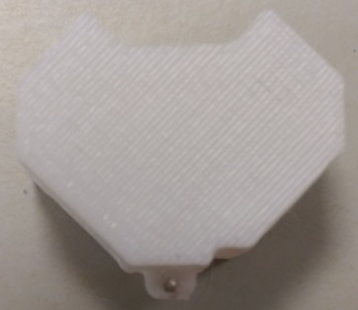
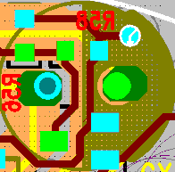
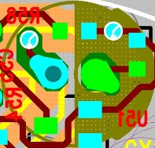
Corrective Action
Use plastic cover instead of the tape which let fixing glue sufficiently adhered.
And add a fixing pin increase structure force.
Increase the soldering
area of C52

Slide 7
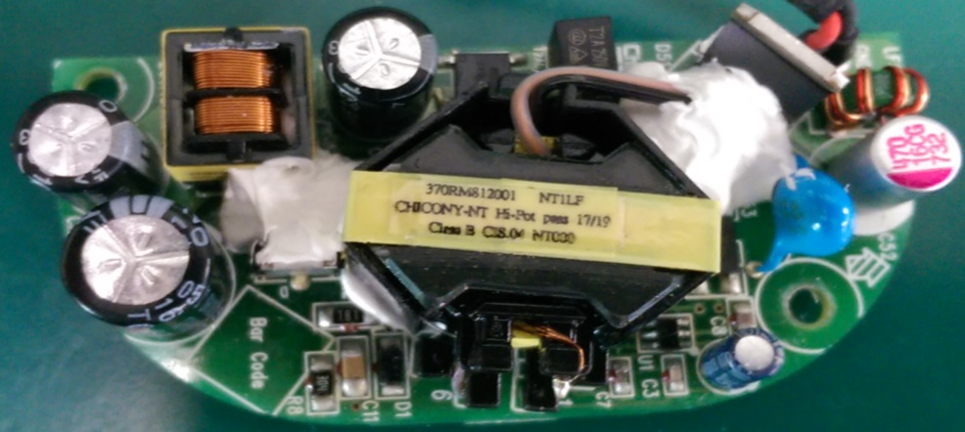
Preventive Action
Test condition :the height 100cm fall in the cement by random 100 times
The Specification are too strict with general test standard.
Customer modify the test condition to 1.0m fall in the cement, a total of 30 times
Automated glue add control to prevent the risk of manual instability.

